Slide 1
Hotel Booking Dataset Analysis Presentation

Slide 2
I am pleased to present our comprehensive analysis of this hotel booking dataset, which represents a substantial collection of hospitality industry data encompassing 36,275 individual booking records across 17 distinct variables that collectively paint a detailed picture of customer booking behaviors, preferences, and outcomes in the hotel industry.
This meticulously structured dataset captures the complete customer journey from initial booking to final status determination, featuring critical demographic information such as the number of adults and children per booking, accommodation preferences including the number of weekend nights versus weekday nights stayed, and sophisticated categorical variables that segment customers by their meal plan selections, room type reservations, and market segment classifications.

Slide 3
OUR PROCESS
Loading The Data
03. Data Cleaning
06. Data Preprocessing
02. EDA (Exploratory Data Analysis)
04. Data Analysis & Visualization
05. Deployment
(Using Streamlit)

Slide 4
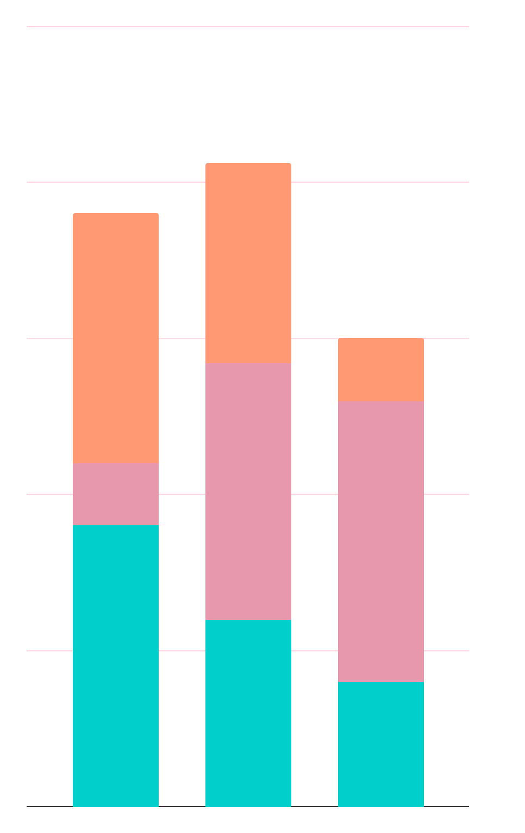
Loading The Data
Loading the file from the data source and getting to know my data in order to check for data types and etc..

Slide 5
02. Data Exploration (EDA)
In this stage, I check for many things in my dataset like:
Checking for data types and null values
Creating new columns if necessary
Describing the data (seeing minimum, maximum, mean value of each column in order to detect outliers)
Checking for null values

Slide 6
03. Data Cleaning
Data cleaning is the process of identifying and correcting errors, inconsistencies, and inaccuracies in datasets to ensure data quality and reliability for analysis.
Identification: Detect null values, empty strings, placeholders like "N/A", "Unknown"
Duplicate Detection & Removal
Data Type Corrections
Outlier Detection & Treatment (using IQR, Z-Score)
Consistency Checks (Ensure data follows logical constraints)
Libraries used to clean the data:
Pandas

Slide 7
04. Data Analysis & Visualization
Exploratory Data Analysis (EDA) and visualization help understand data patterns, relationships, and insights through statistical analysis and graphical representations reviewing:
Univariate Analysis
Bivariate Analysis
Multivariate Analysis
Libraries used to visualize the data:
Pandas
Plotly.express
Seaborn

Slide 8
05. Deployment(Using Streamlit)
Streamlit is a powerful, open-source Python framework that allows you to quickly and easily deploy data apps , dashboards , and machine learning tools with minimal effort.
It’s especially popular among data scientists, analysts, and machine learning engineers who want to turn their scripts or notebooks into interactive web applications without needing front-end development experience.
Libraries used to visualize the data:
Pandas
Plotly.express
Streamlit

Slide 9
06. Data Preprocessing
Data preprocessing transforms raw, cleaned data into a format suitable for machine learning algorithms through encoding, scaling, and feature engineering.
Libraries used to visualize the data:
Pandas
sklearn
Binary Encoders

Slide 10
THANK YOU FOR YOUR TIME!
Do you have any questions?

